Slide 1
IRCBG_20081
“Metagenomica e culturomica: aspetti complementari della "microbiologia omica"
Colorectal cancer: metagenomics in diagnostic pratice

Slide 2
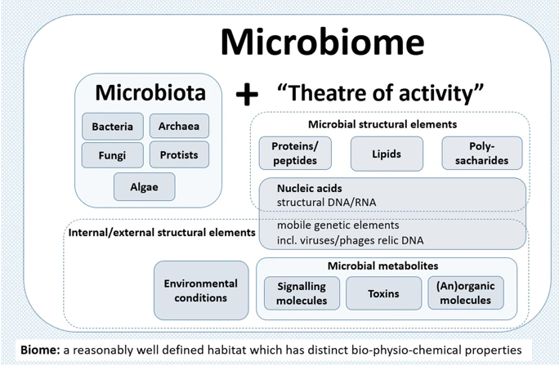
What is the microbiome?
Berg et al. Microbiome. 2019
Notes:
The microbiome is defined as a characteristic microbial community occupying a reasonable well-defined habitat which has distinct physio-chemical properties. The microbiome not only refers to the microorganisms but also encompasses their theatre of activity including microbial structures, metabolites, mobile genetic elements (e.g., transposons, phages, and viruses), and relic DNA embedded in the environmental conditions of the habitat.

Slide 3
What is the oncomicrobiome?
“Configurations” of our microbiome than can influence cancer in several different ways
As a causal agent in the development of tumors
Modulating our response to treatment
Influencing cancer associated comorbidities
Ex: by producing toxins and/or metabolites
Affecting our response to chemotherapy and immunotherapy
Ex: Cancer cachexia, obesity

Slide 4
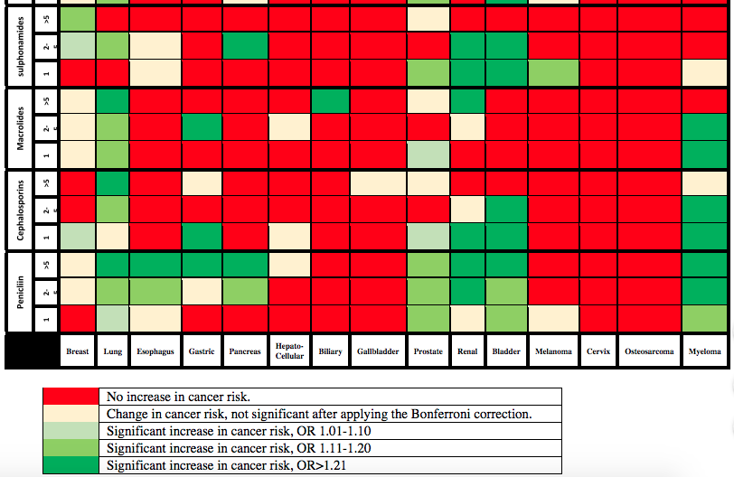
Epidemiological evidence of the oncomicrobiome
Use of antibiotics and cancer risk
Based on:
125,441 cases
and
490,510 matched controls
Boursi et al . Eur J Cancer. 2016

Slide 5
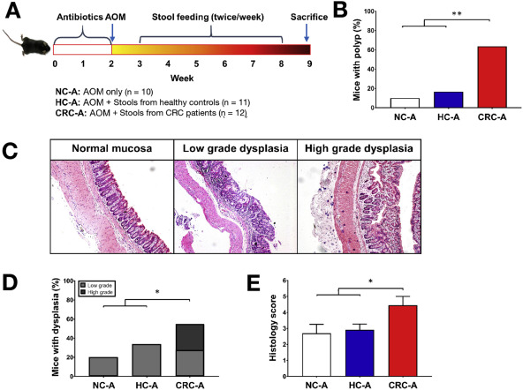
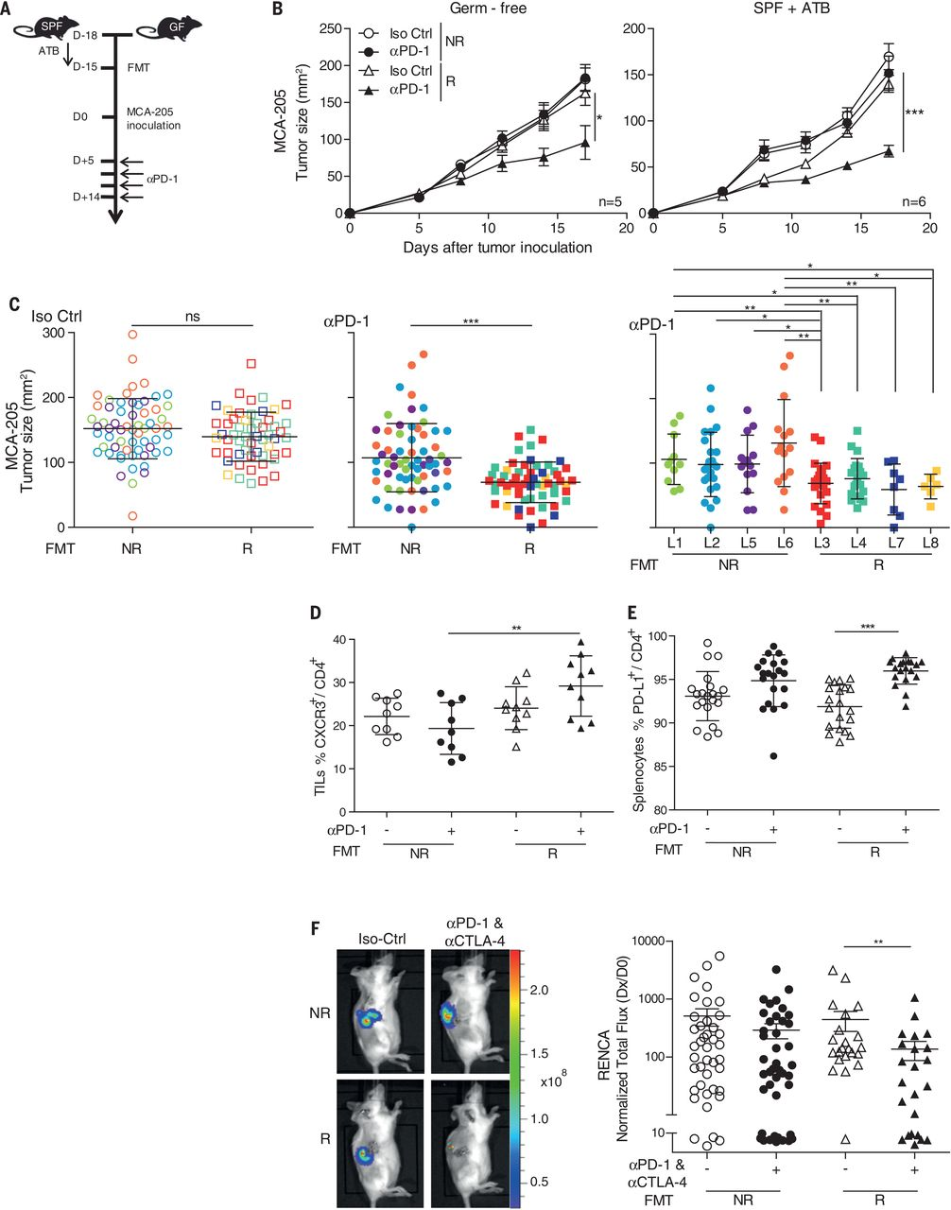
Experimental evidence of the oncomicrobiome
Gavage of an oncogenic stool microbiome
Gavage of stool from responder patients improves response to immunotherapy
Routy et al. Science. 2018
Wong et al. Gastroenterology. 2016

Slide 6
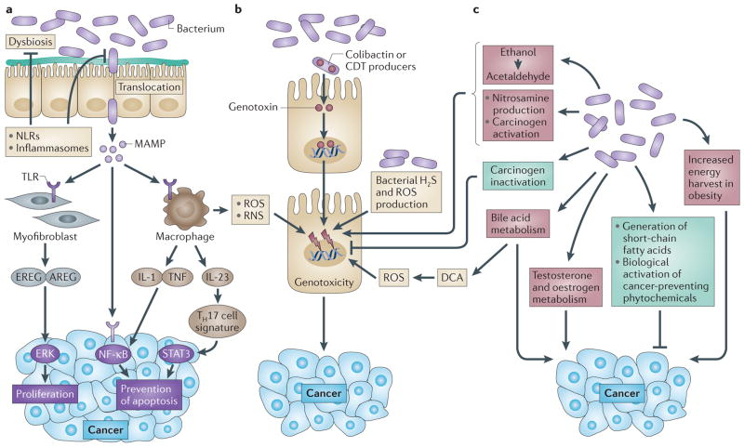
Mechanisms of microbial carcinogenesis in colorectal cancer
Changes in the microbiome
Genotoxins
Microbial metabolites
Schwabe RF & Jobin C. Nature Rev Cancer. 2013

Slide 7
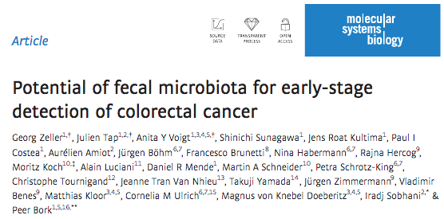
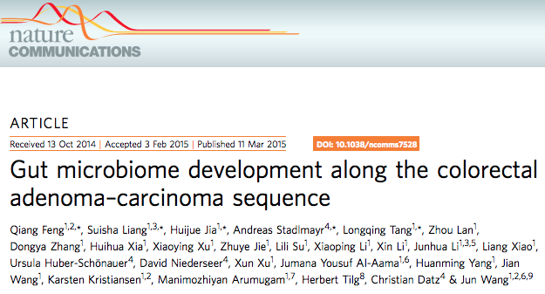
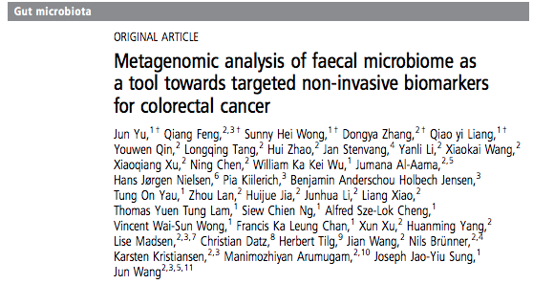
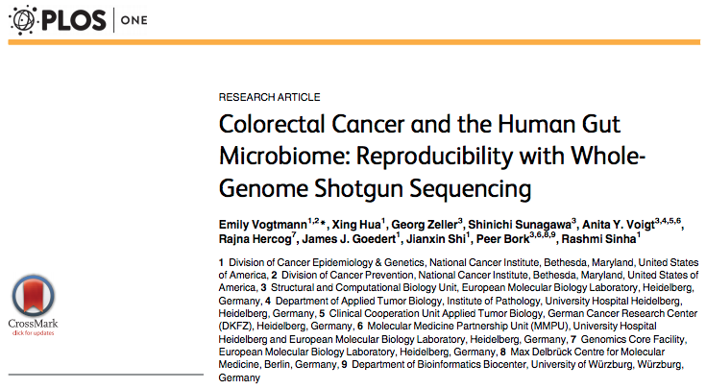
The diagnostic potential of the gut microbiome in CRC

Slide 8
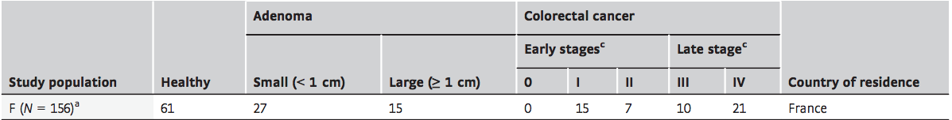
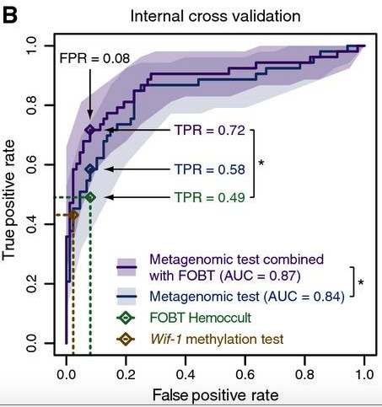
The diagnostic potential of the gut microbiome in CRC
Machine learning:
- High prediction of CRC using the gut microbiome
- Increased sensitivity (45%) when combined with FOBT
Is this diagnostic potential also seen across cohorts?
Zeller et al. Mol Systems Bio. 2014

Slide 9
Cohorts
Dataset | Total | Controls | Adenomas | CRC | No. of reads (×10⁹) | Country
CM_Cohort1 | 80 | 24 | 27 | 29 | 8.2 | Italy
CM_Cohort2 | 60 | 28 | - | 32 | 5.1 | Italy
ZellerG_2014 | 156 | 61 | 42 | 53 | 9.4 | France
YuJ_2015 | 128 | 54 | - | 74 | 7.2 | China
FengQ_2015 | 154 | 61 | 47 | 46 | 8.3 | Austria
VogtmannE_2016 | 104 | 52 | - | 52 | 6.9 | USA
HanniganGD_2017 | 82 | 28 | 27 | 27 | 0.5 | USA, Canada
Validation Cohort1 | 125 | 65 | - | 60 | 6.8 | Germany
Validation Cohort2 | 80 | 40 | - | 40 | 3.6 | Japan
Total | 969 | 413 | 143 | 413 | 56 | --
In collaboration with:
CM_Cohort 1: Dr. Alessio Naccarati, Italian Institute for Genomic Medicine, Turin
CM_Cohort2: Prof. Maria Rescigno, Humanitas Research Hospital, Milan
Dr. Sara Gandini & Dr. Davide Serrano, IEO, Milan
Thomas, Manghi et al. Nat Med. 2019

Slide 10
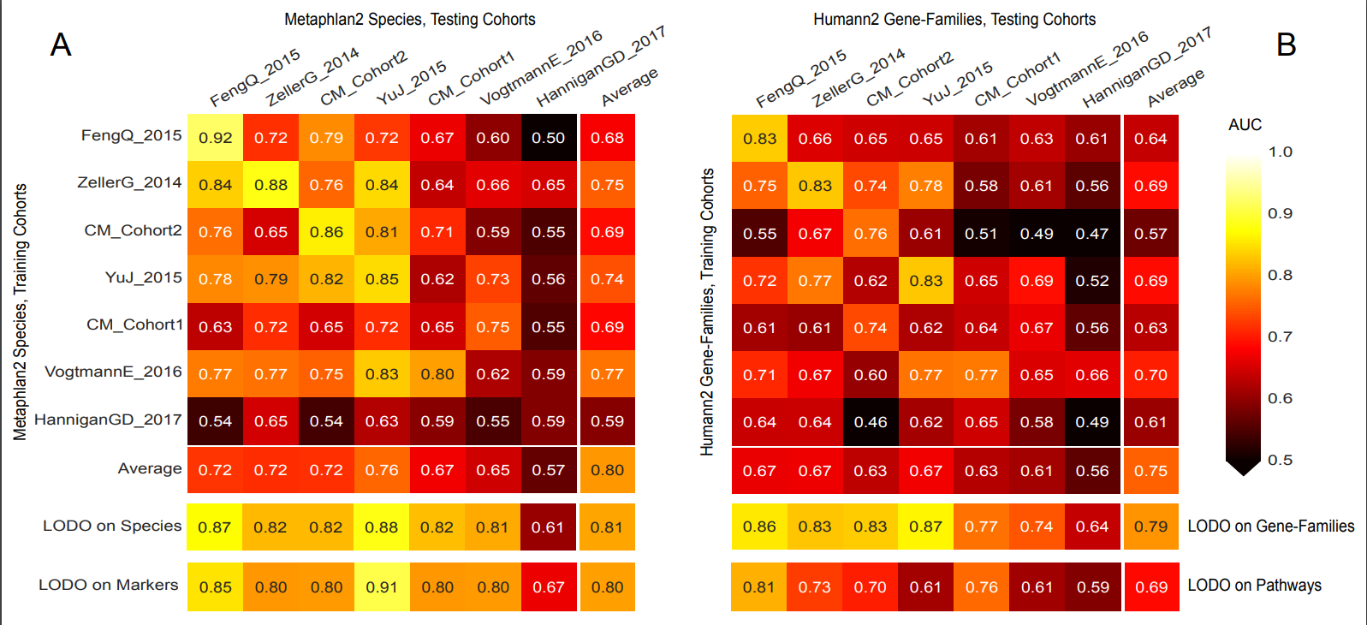
Can the gut microbiome detect CRC across datasets?
Average
Yes, but some datasets predict CRC better than others
Thomas, Manghi et al. Nat Med. 2019

Slide 11
Can the gut microbiome detect CRC across datasets?
Average
Average
There is a poor transportability of one dataset to another
Thomas, Manghi et al. Nat Med. 2019

Slide 12
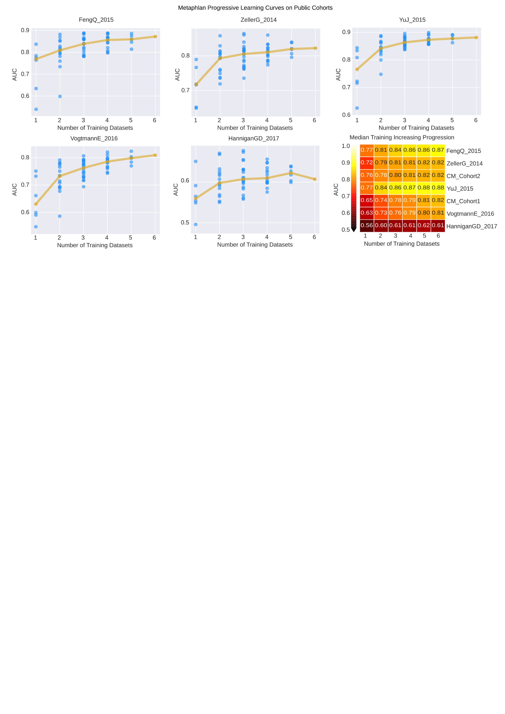
Can the gut microbiome detect CRC across datasets?
Combining datasets improves prediction
Thomas, Manghi et al. Nat Med. 2019

Slide 13
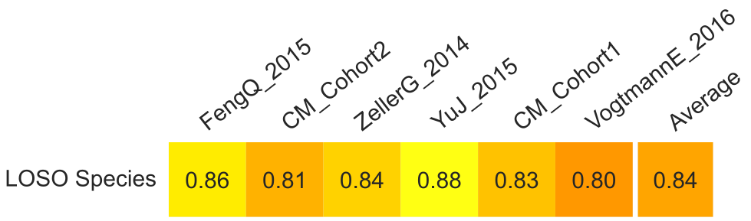
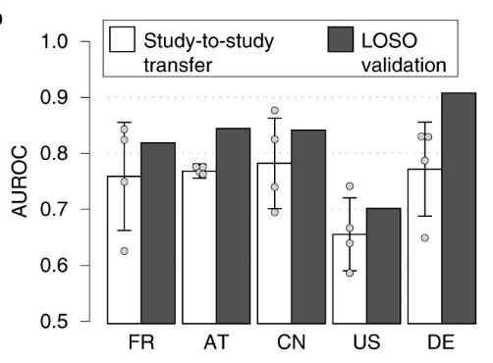
Can the gut microbiome detect CRC across datasets?
Combining datasets improves prediction
Wirbel et al. Nat Med 2019
Partial overlap in samples
Different taxonomic profiling
Different machine learning models (LASSO models)

Slide 14

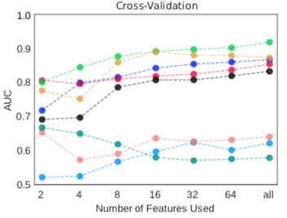
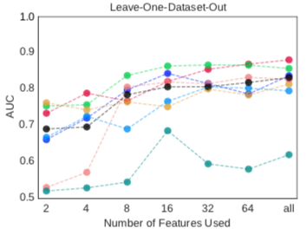
Features can be minimized
16 species achieved cross-validation AUC >0.8 for most datasets, with little improvement from using all remaining species (2% average improvement in AUC value).
Thomas, Manghi et al. Nat Med. 2019

Slide 15
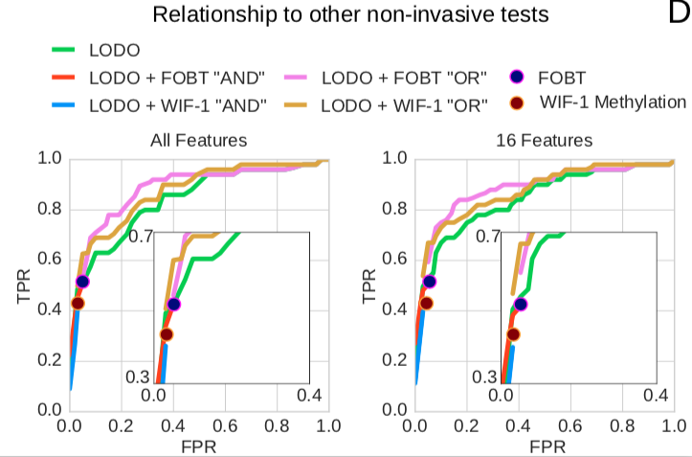
Relationship to other non-invasive clinical tests
LODO OR Fecal occult blood test (FOBOT) improves the sensitivity/specificity trade-off at high specificity levels
16 features generally improved the results
Thomas, Manghi et al. Nat Med. 2019

Slide 16
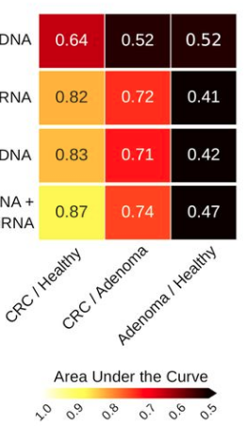
Combining –omics to detect CRC
Metagenomics
Small bacterial RNAs
Metagenomics
+ Small bacterial RNAs
Metagenomics
+ Small bacterial RNAs
+ Small human RNAs
Tarallo et al. mSystems. 2019

Slide 17
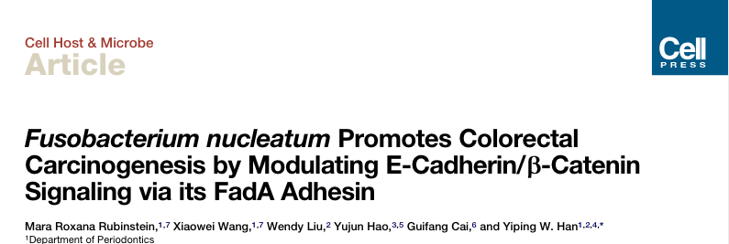
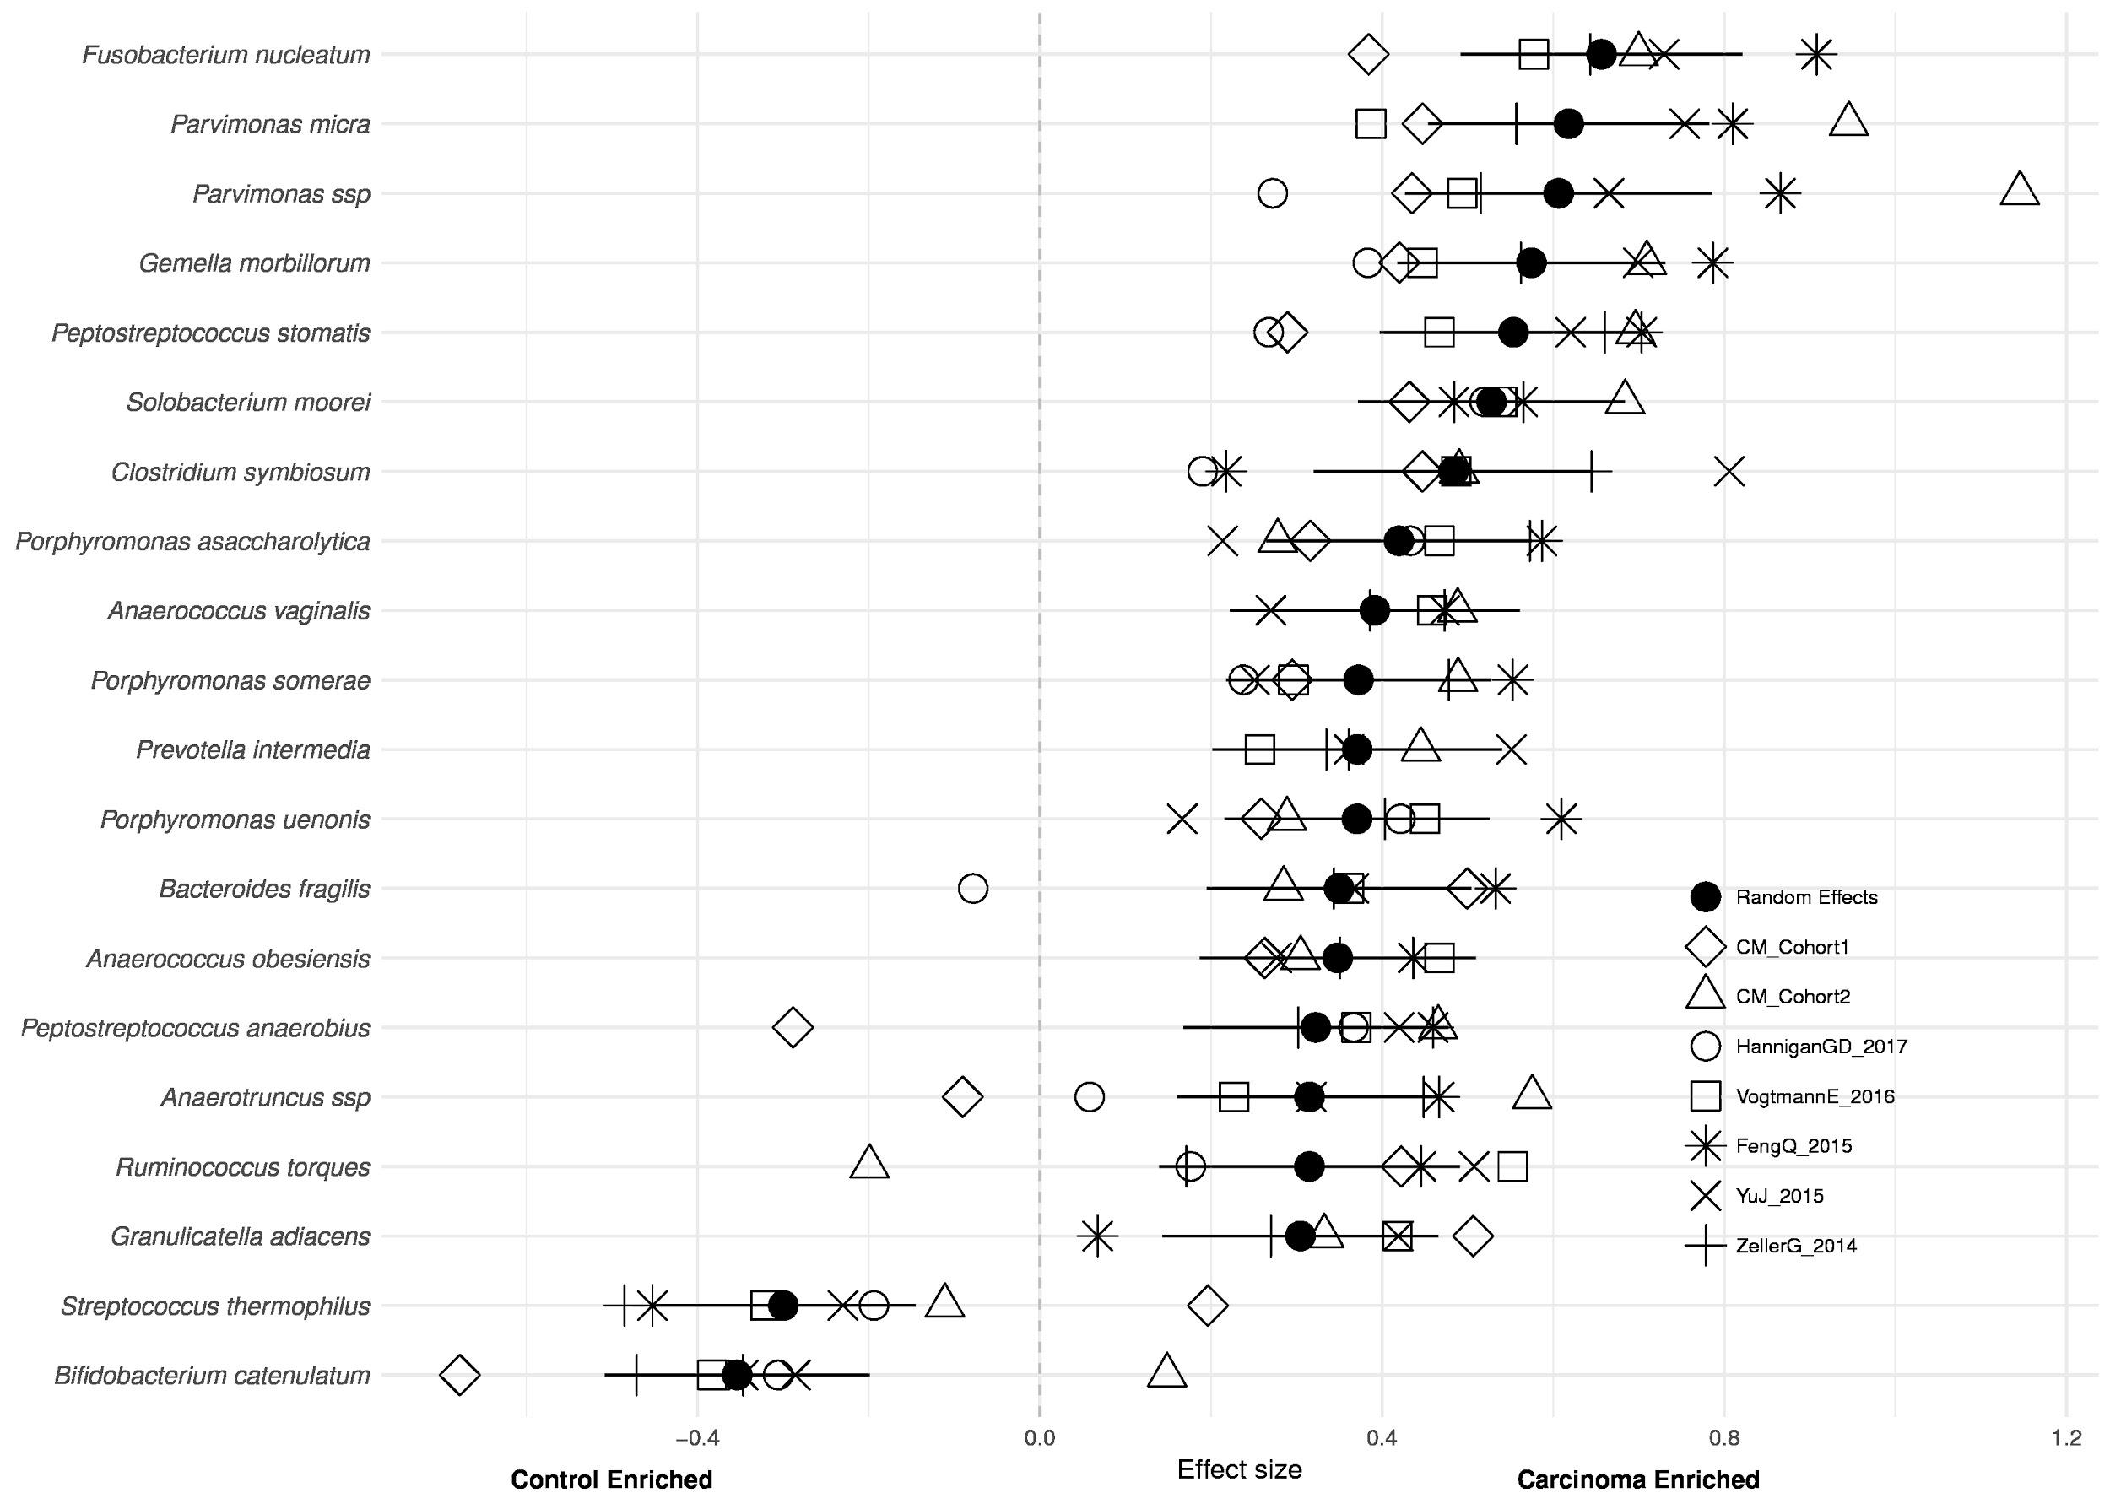
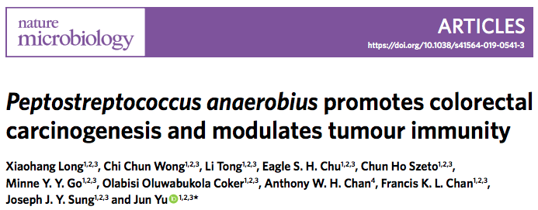
Reproducible biomarkers
Fusobacterium nucleatum
Parvimonas micra
Parvimonas spp
Gemella morbillorum
Peptostreptococcus stomatis
Solobacterium moorei
Clostridium symbiosum
Porphyromonas asaccharolytica
Anaerococcus vaginalis
Porphyromonas somerae
Prevotella intermedia
Porphyromonas uenois
Bacteroides fragilis
Anaerococcus obesiensis
Peptostreptococcus anaerobius
Anaerotruncus spp
Ruminococcus torques
Granulicatella adiancens
Streptococcus thermophilus
Bifidobacterium catenulatum
Thomas, Manghi et al. Nat Med. 2019

Slide 18
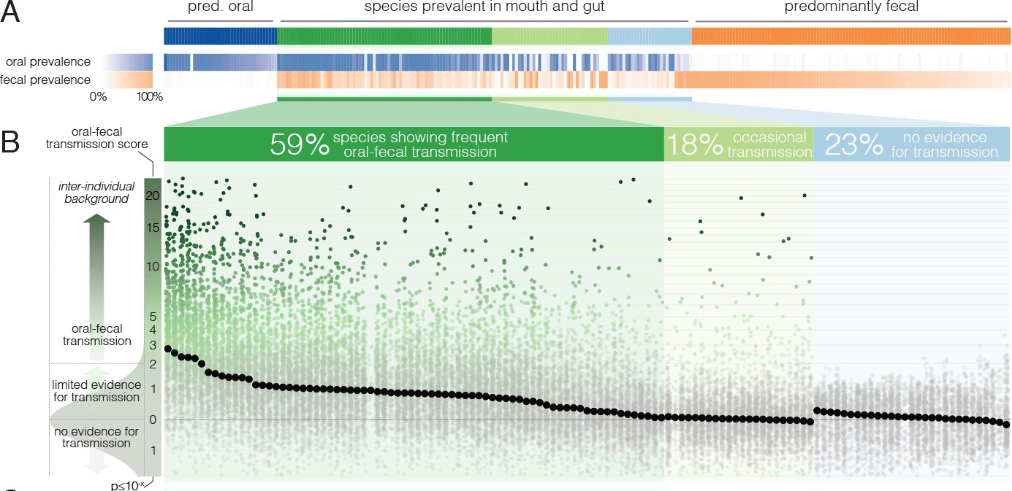
Oral fecal-transmission
N = 470
310 species
Schmidt et al. elife. 2019
Out of 125 species, 77% showed evidence of oral-fecal transmission: Streptococcus, Veillonella, Actinomyces and Haemophilus
Notes:
Salivary and fecal microbial strain populations of 310 species in 470 individuals from five countries

Slide 19
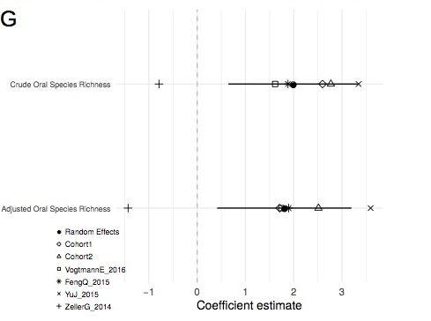
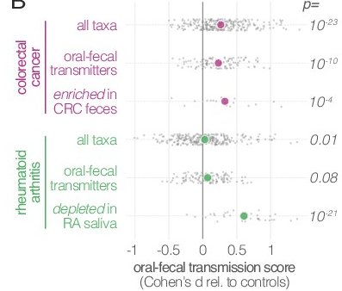
Oral fecal-transmission
Controls
Carcinomas
Schmidt et al. elife. 2019
Thomas, Manghi et al. Nat Med. 2019
Notes:
Salivary and fecal microbial strain populations of 310 species in 470 individuals from five countries

Slide 20
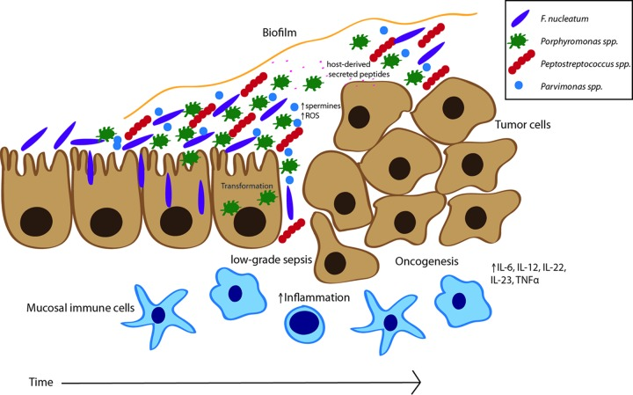
Oral species, biofilms and CRC formation
Flynn et al. mSphere 2016.

Slide 21
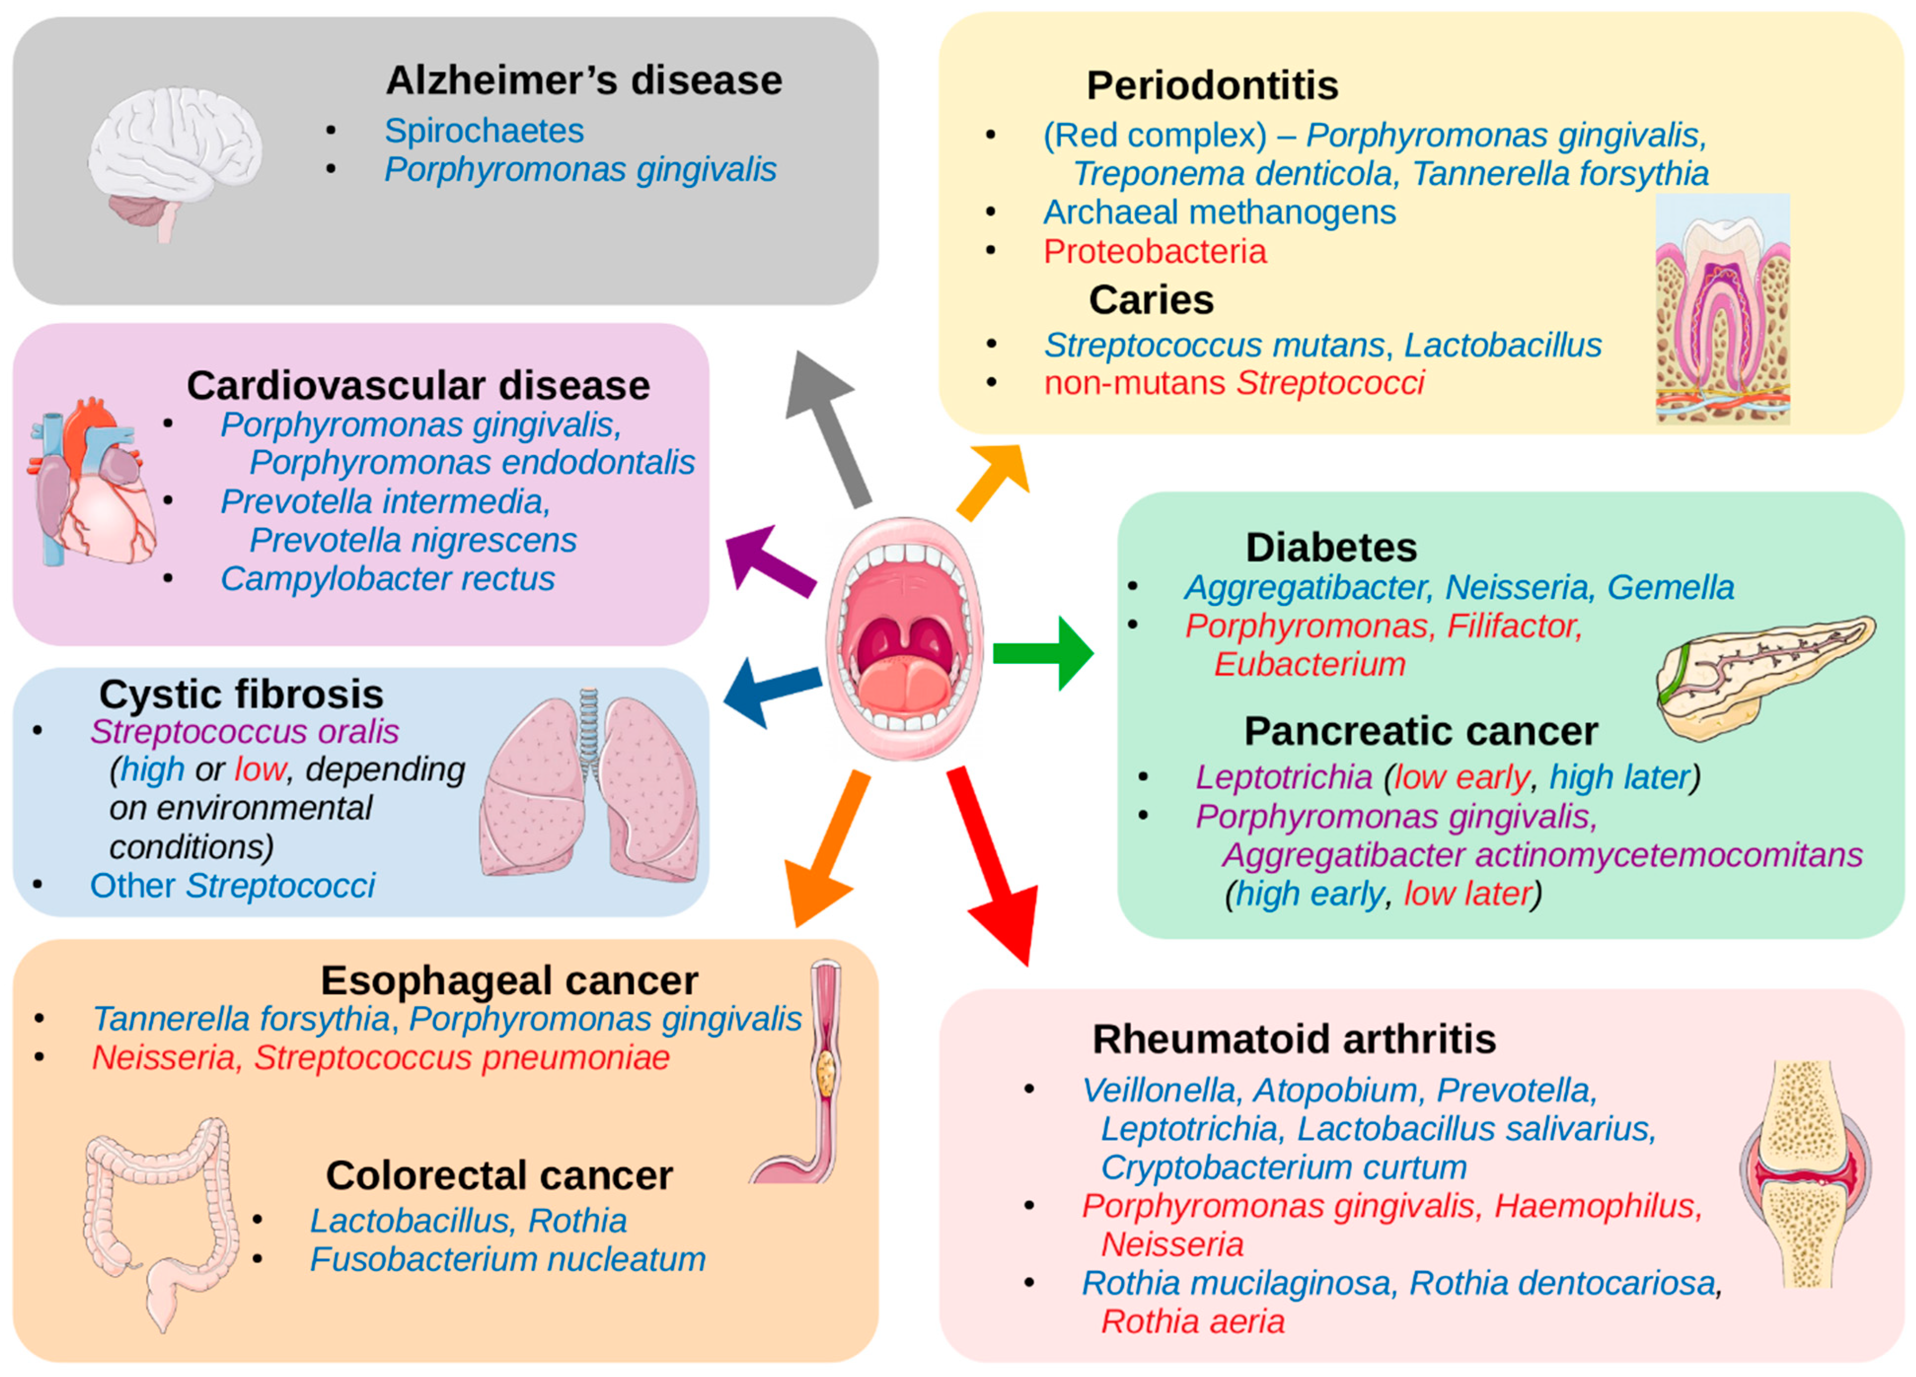
The oral microbiome and disease
Willis, Gabaldon. Microorganisms. 2020

Slide 22
Reproducible biomarkers
CRC: Putrefaction, gluconeogenesis
Controls: diet associated changes
Thomas, Manghi et al. Nat Med. 2019
Notes:
Shift from dietary carbohydrate utilization in a healthy gut microbiome to amino acid degradation/putrefaction in CRC

Slide 23
TMA production by the gut bacteria
Presented by: Andrew M. Thomas – AC Camargo Cancer Center

Slide 24
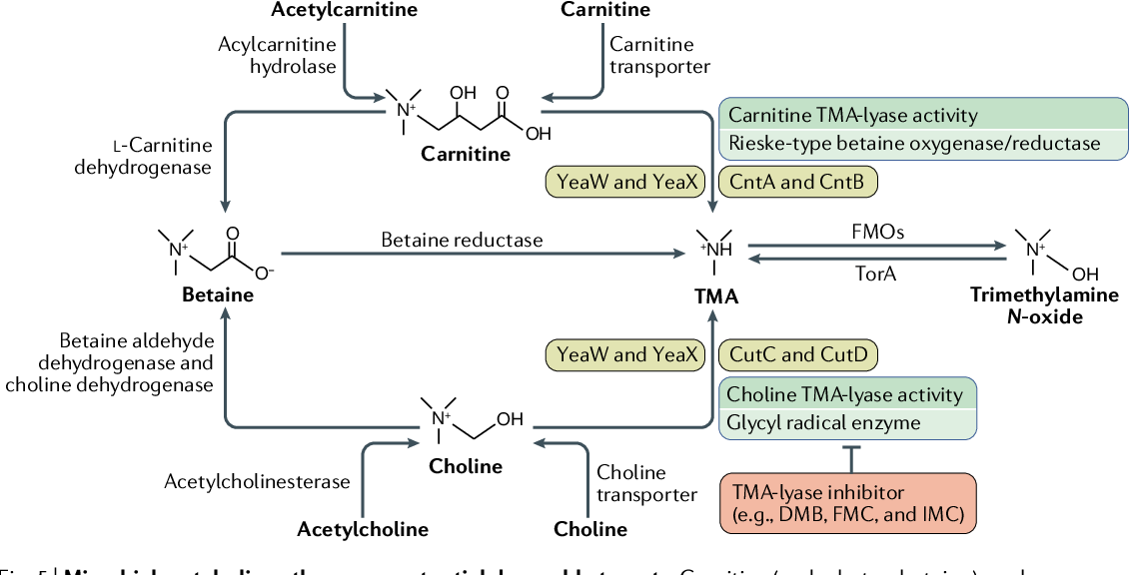
TMA production by the gut bacteria

Slide 25
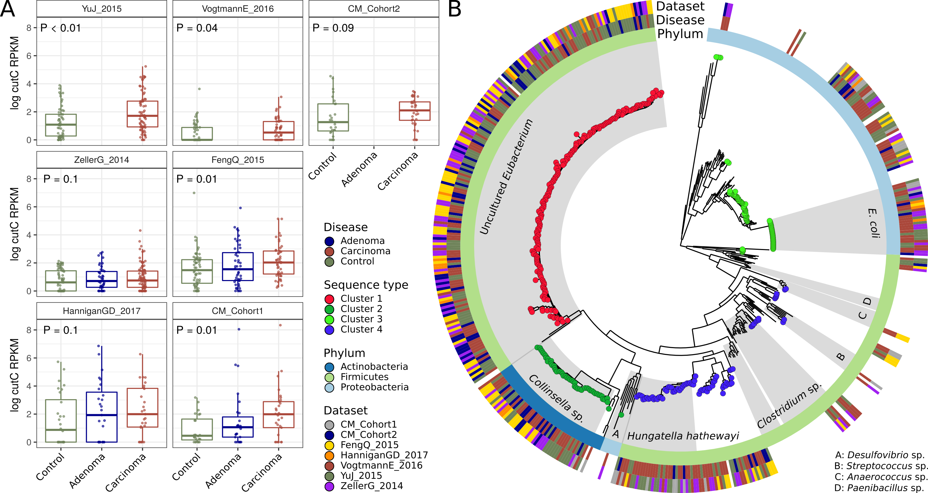
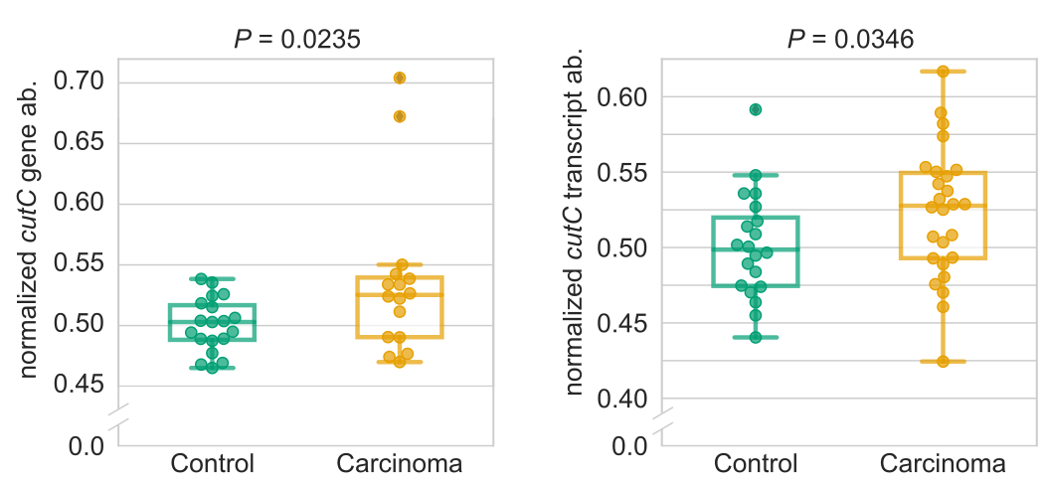
Microbial TMA producing genes and CRC
Increased abundance of choline TMA-lyases in 4/7 datasets and in meta-analysis (p = 0.002, I² = 0%, Q-test = 0.7)
Increased abundance and transcription by qPCR
Thomas, Manghi et al. Nat Med. 2019
Thomas, Manghi et al. Nat Med. 2019

Slide 26
Microbial TMA producing genes and CRC
Different sequence subtypes correlate with disease status
Odds Ratio 0.38
95% CI [0.25, 0.57]
Odds Ratio 1.85
95% CI [1.13, 3]
Odds Ratio 2.14
95% CI [1.29, 3.56]
Thomas, Manghi et al. Nat Med. 2019

Slide 27
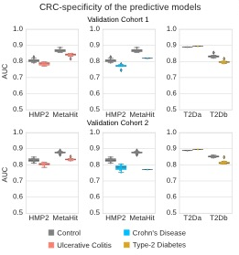
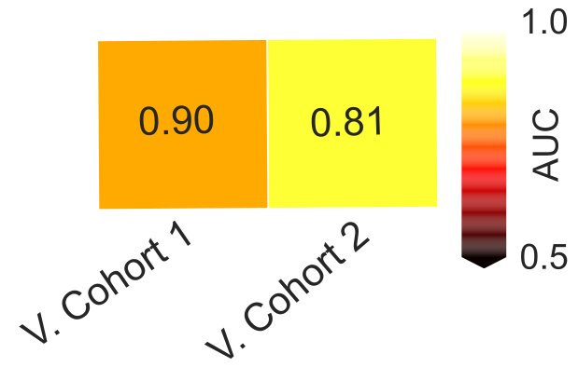

Validation in additional datasets
High predictions using LOSO models
Increased cutC
abundance
CRC model remained highly predictive and specific (AUC ≥ 0.80).

Slide 28
In Summary
Diagnostic potential of the gut microbiome for CRC detection across cohorts
CRC-specific detection of the microbiome
Use of a minimal microbial signature for CRC detection
Reproducible taxonomic/functional microbial biomarkers across datasets
Choline degrading microbial enzymes may be relevant in CRC

Slide 29


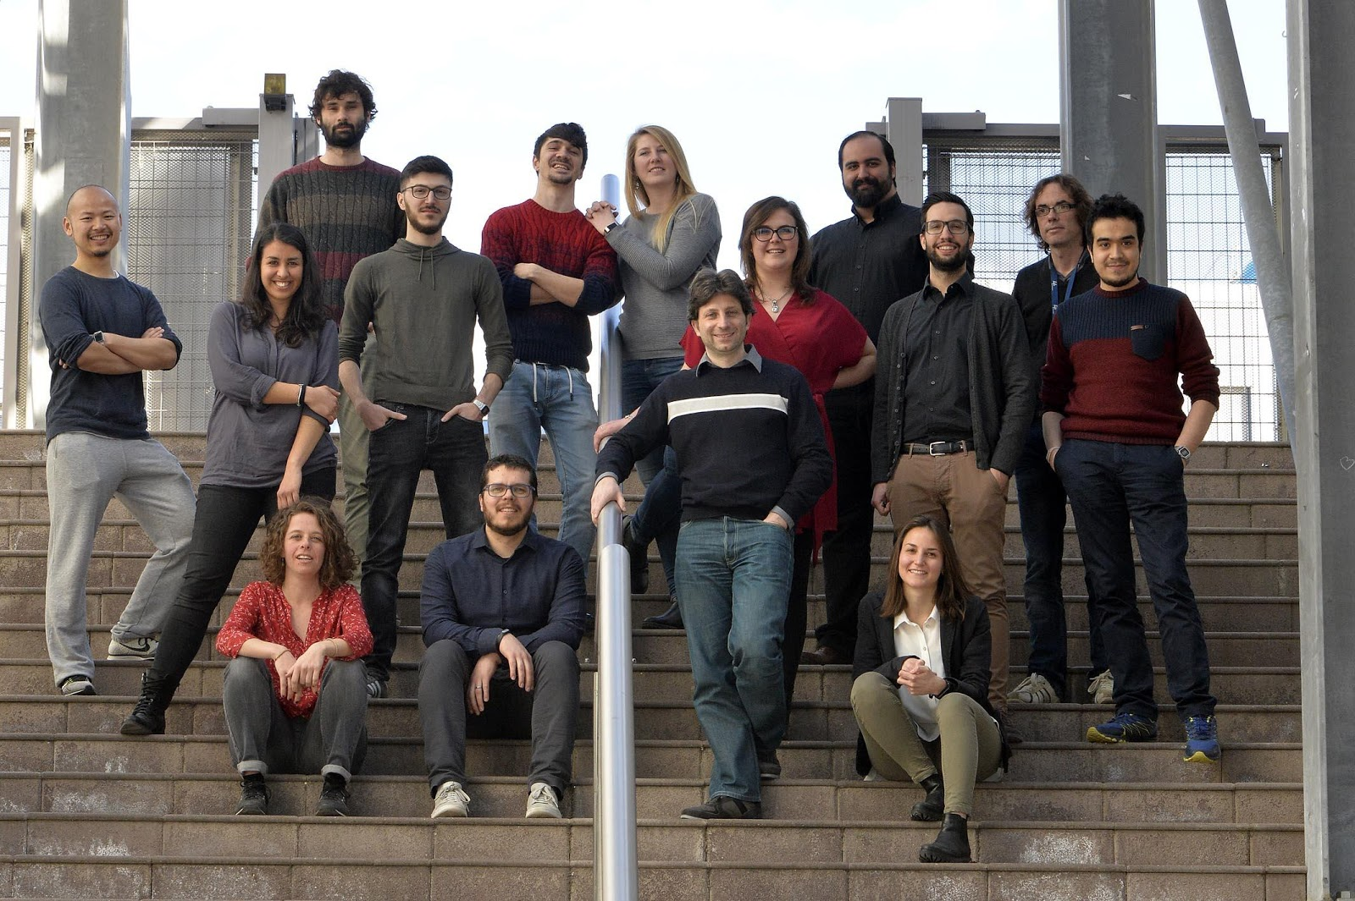




The Computational Metagenomics Laboratory
PI Nicola Segata
@cibiocm
http://segatalab.cibio.unitn.it
Adrian Tett
Federica Pinto
Federica Armanini
Francesco Asnicar
Giulia Masetti
Fabio Cumbo
Mireia Valles-Colomer
Aitor Blanco
Serena Manara
Paolo Ghensi
Moreno Zolfo
Kun Huang
Francesco Beghini
*Paolo Manghi
Nicolai Karcher
Leonard Dubois
Eleonora Nigro
Chiara Mazzoni
Gianmarco Piccinno
Germana Baldi
IGM
IEO
Clinica Santa Rita
Humanitas
Alessio Naccariti
Barbara Pardini
Sonia Tarallo
Antonio Francavilla
Davide Serrano
Sara Gandini
Chiara Pozzi
Gaetano Gallo
Mario Trompetto
Maria Rescigno
Georg Zeller
Peer Bork
Manimozhiyan Arumugam
Emmanuel Dias-Neto
João Carlos Setubal
University of Turin
University of Naples
CUNY
Francesca Cordero
Giulio Ferrero
Edoardo Pasolli
Levi Waldron

